Slide 1
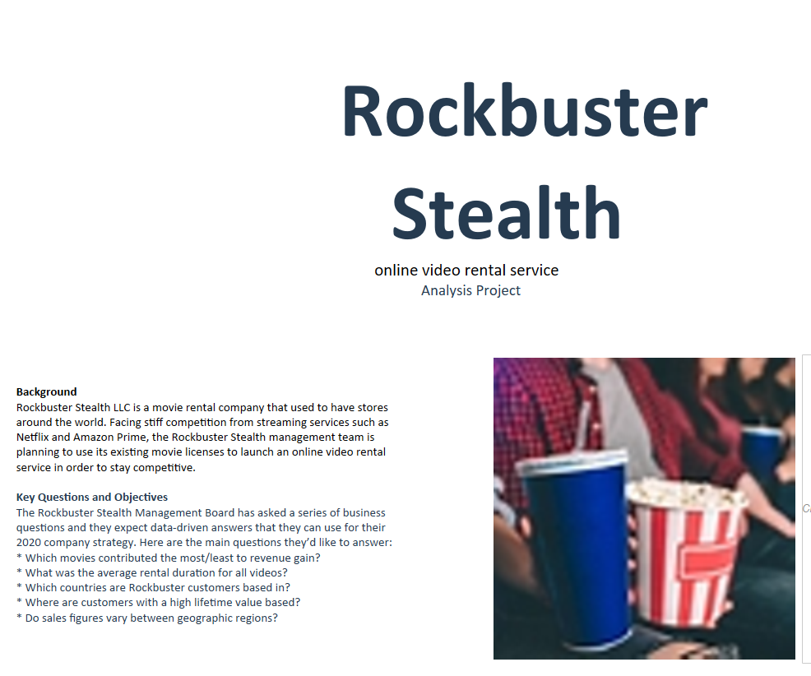

Slide 2
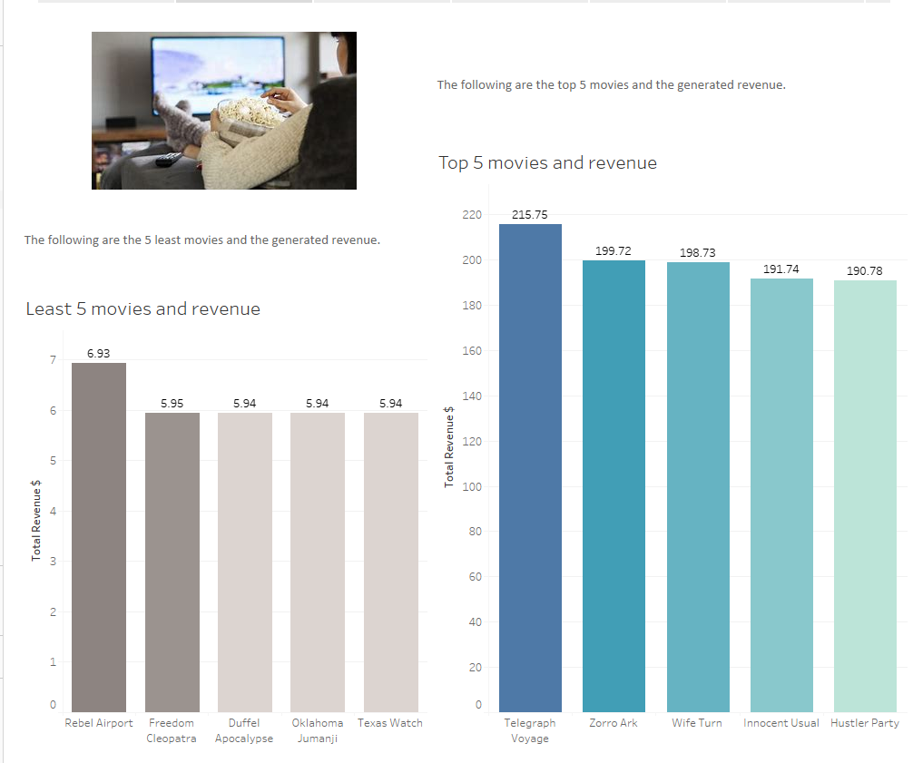

Slide 3
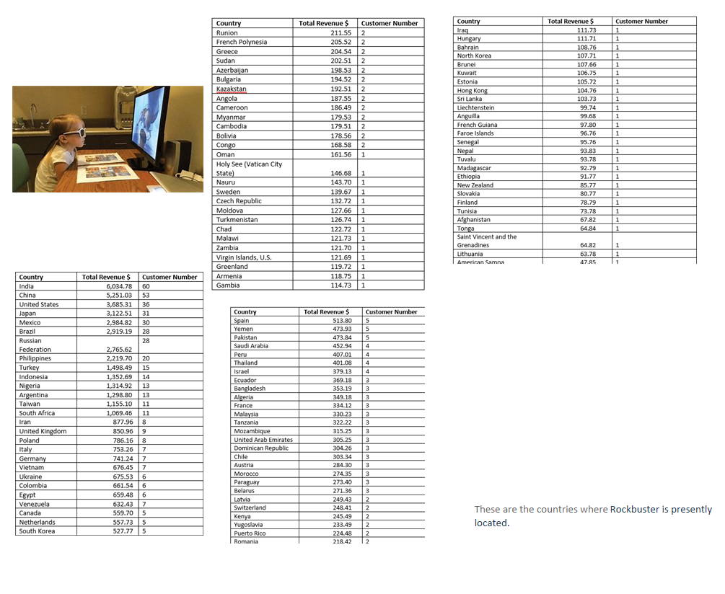

Slide 4
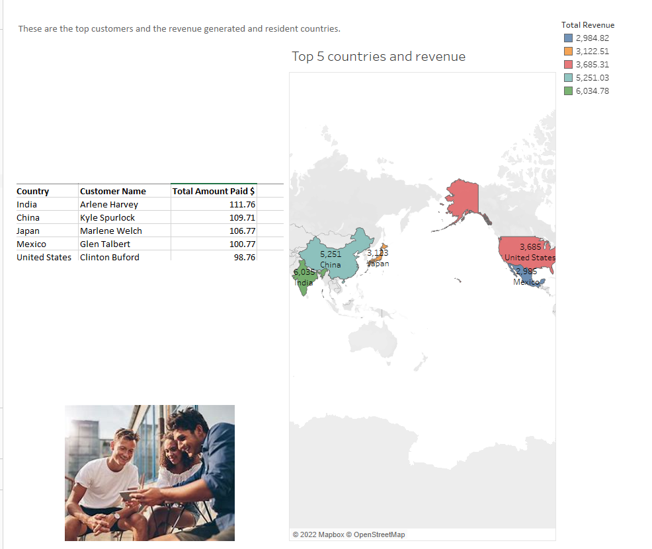

Slide 5
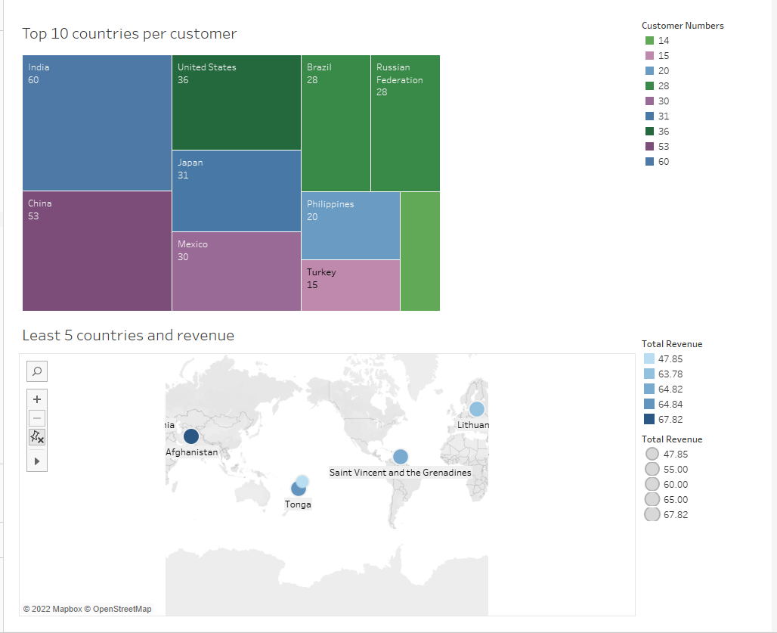

Slide 6
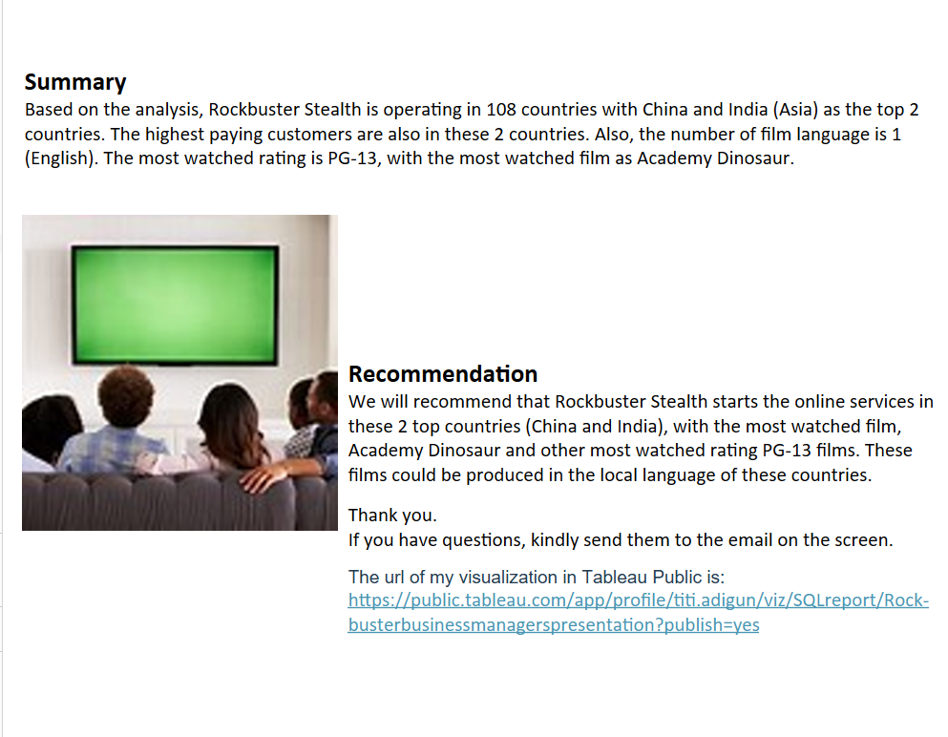

Slide 7
The url of my visualization in Tableau Public is:
https://public.tableau.com/app/profile/titi.adigun/viz/SQLreport/Rockbusterbusinessmanagerspresentation?publish=yes
The link to the coding is: https://1drv.ms/x/s!AmMGMFF1a6fnc4inQwvYs4BuLgI?e=WLap1w

